Slide 1


FHSU Engagement Series University Data Resources

Slide 2
What are the things you should be able to do after today’s discussion?
Identify and locate a variety of internal and external data tools that could support your work
Gain a general understanding of the sources behind these tools
Determine whether you or someone in your unit has access to these data tools
Recognize some of the datapoints and information available in each data tool
Explore potential use cases for these tools in your role

Slide 3
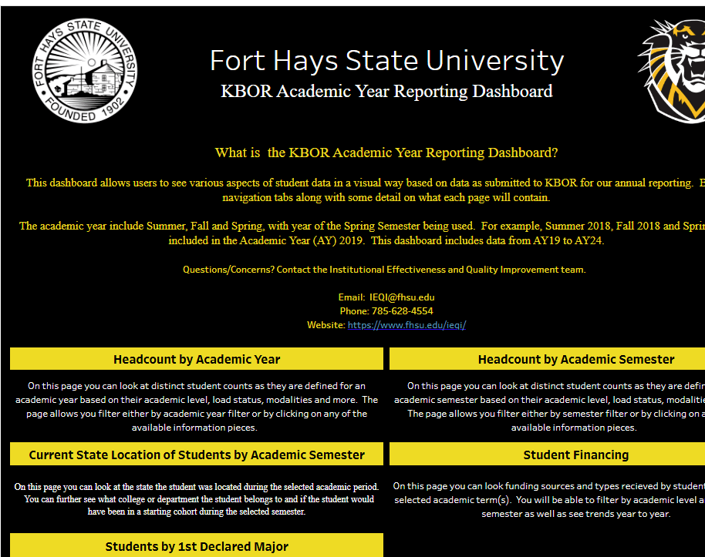
KBOR Academic Year Reporting Dashboard
Where is it located:
FHSU.edu/ieqi/dashboards
Source:
internal reporting FHSU provides to KBOR
Who has access:
Open
Data/Information you’ll find:
Headcount, student origin/financing/1st Major
Potential use cases:
*Identify trends
*Understand the makeup of your college, dept, program, advisees
*Know where your students are coming from and their financial needs

Slide 4
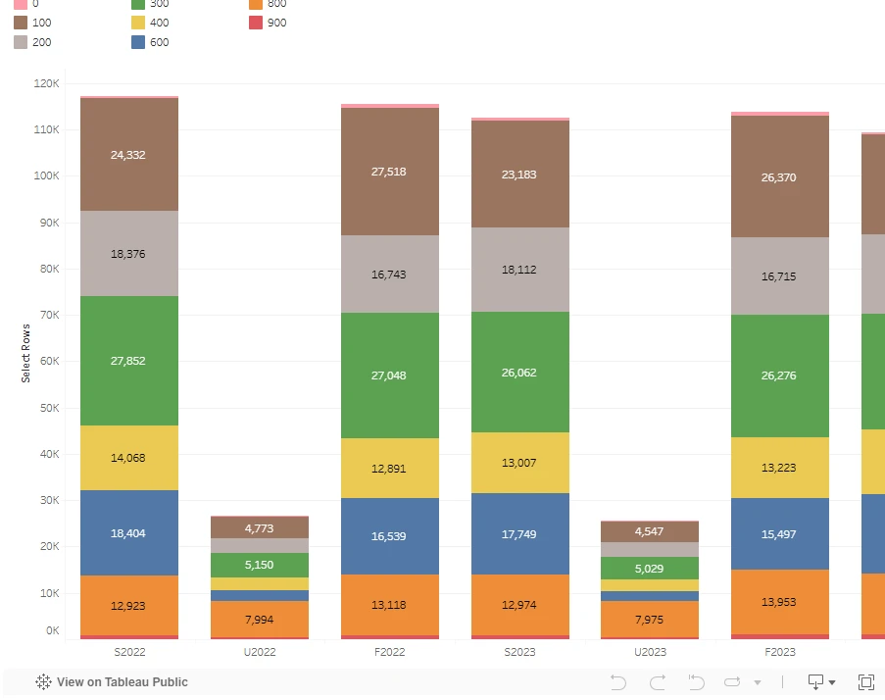
Course Dashboard
Where is it located:
FHSU.edu/ieqi/dashboards
Source:
internal reporting generated from course enrollments
Who has access:
Open
Data/Information you’ll find:
Disaggregated course enrollment, SCH, and grade performance
Potential use cases:
*Trends in course enrollment delivery modality
*Student performance metrics over time
*College, Department, Course production

Slide 5
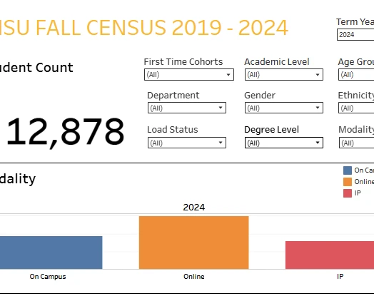
Fall Census (20th Day) Dashboard
Where is it located:
FHSU.edu/ieqi/dashboards
Source:
internal reporting FHSU provides to KBOR
Who has access:
Open
Data/Information you’ll find:
Fall “20th Day” enrollments by Degree level and Load Status
Potential use cases:
*Enrollments by College, Department, & Degree Level
*Identify changes in enrollment behaviors by student type
*Monitor demographical shifts in enrollments

Slide 6
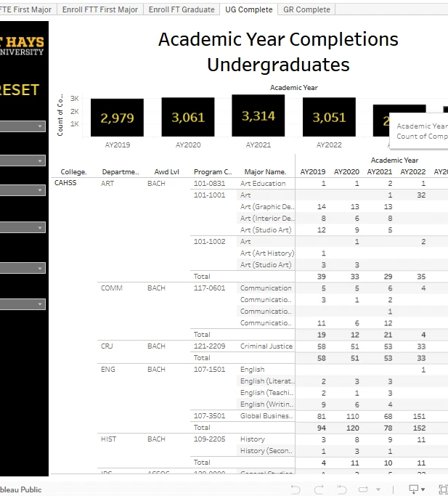

Program Review Dashboard: Fall Census Headcounts and AY Completions
Where is it located:
FHSU.edu/ieqi/dashboards
Source:
internal reporting FHSU provides to KBOR/IPEDS
Who has access:
Open
Data/Information you’ll find:
Historical Enrollment and Completions
Potential use cases:
*Address Program Review questions
*Know what credentials graduates are completing
*First time student enrollments and trends

Slide 7
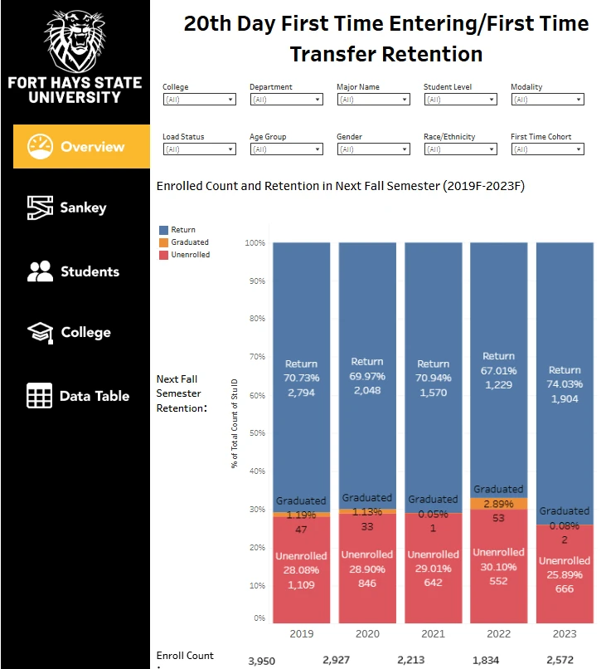
Program Review Dashboard: Retention
Where is it located:
FHSU.edu/ieqi/dashboards
Source:
internal reporting FHSU provides to KBOR
Who has access:
Open
Data/Information you’ll find:
Retention # & % of First Time Entering & First Time Transfer students
Potential use cases:
*Determine rates and trends in persistence and retention
*Identify student cohorts, demographics, programs where rates are high/low
*Target groups for intervention strategies

Slide 8
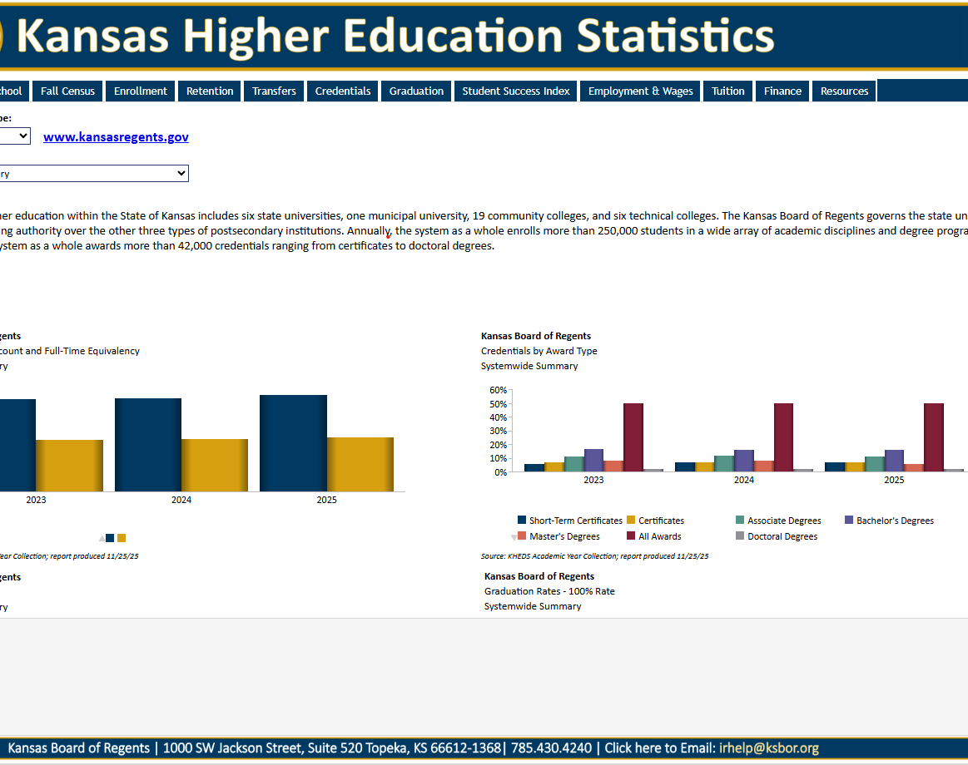
Kansas Higher Education Statistics (KHEStats)
Where is it located:
Kansasregents.gov/data/system_data
Source:
internal reporting from KBOR schools provided to KBOR
Who has access:
Open
Data/Information you’ll find:
Comparison data for aggregated/disaggregated KBOR institutions
Potential use cases:
*Comparison of student outcomes from other regent schools
*Makeup of other regent schools
*Tuition & Financial comparisons students (& their parents) can use to evaluate institutions

Slide 9
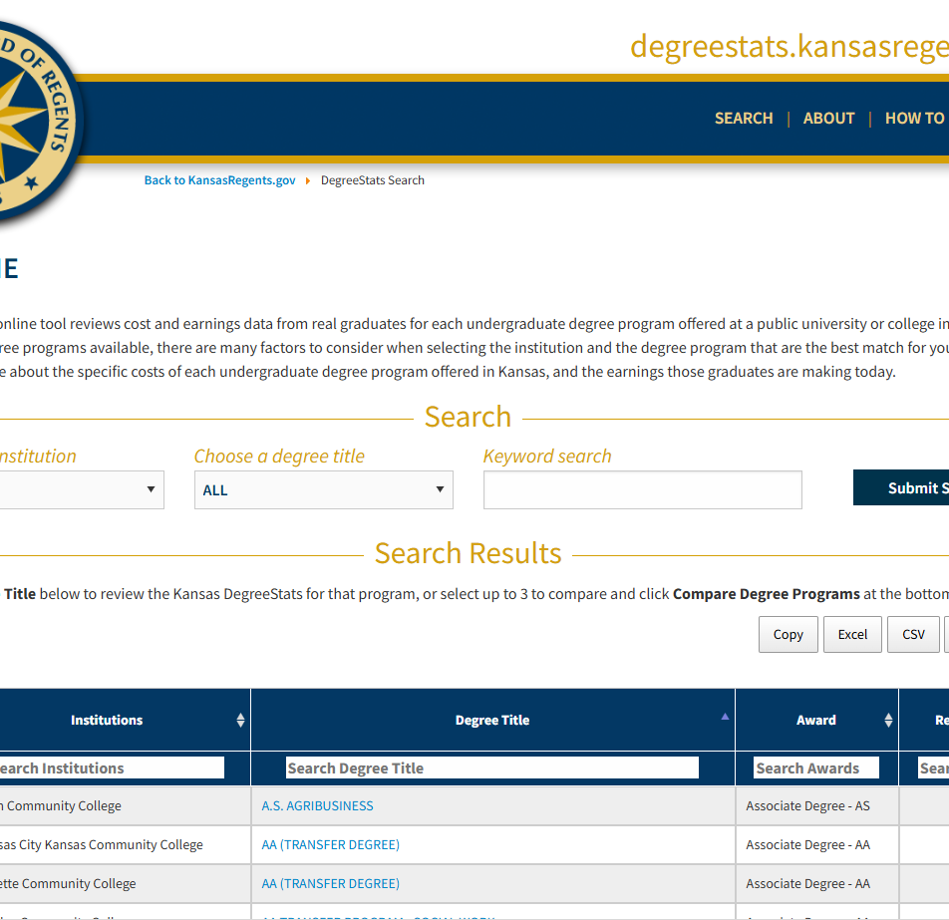
Kansas DegreeStats
Where is it located:
Degreestats.kansasregents.gov
Source:
internal reporting from KBOR schools provided to KBOR & Labor Wage Records from Kansas and Missouri
Who has access:
Open
Data/Information you’ll find:
Annual Cost of Degree, Annual Source of Investment, Wage Information, & Total Loan or Degree Investment
Potential use cases:
*Comparison of student outcomes from other regent schools at a program level
*Determining program graduates remaining in KS/MO
*Tuition & Financial comparisons across institutions at a program level

Slide 10
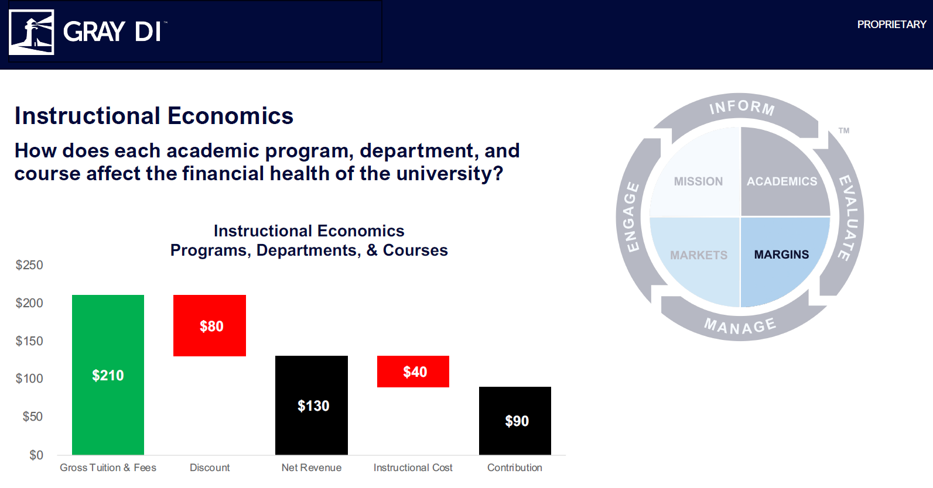
Gray Decision Intelligence PES Economics Tool
Where is it located:
Graydi.us
Source:
internal FHSU data provided to GrayDI; external benchmark data
Who has access:
50 FHSU licenses; Deans/Chairs/Directors
Data/Information you’ll find:
Aggregate & /SCH Economics at a program and course level; course/section metrics; external benchmarks
Potential use cases:
*Identification of high/low margin programs/courses
*Trends of SCH production over time
*Identification of department production across student’s programs of study

Slide 11

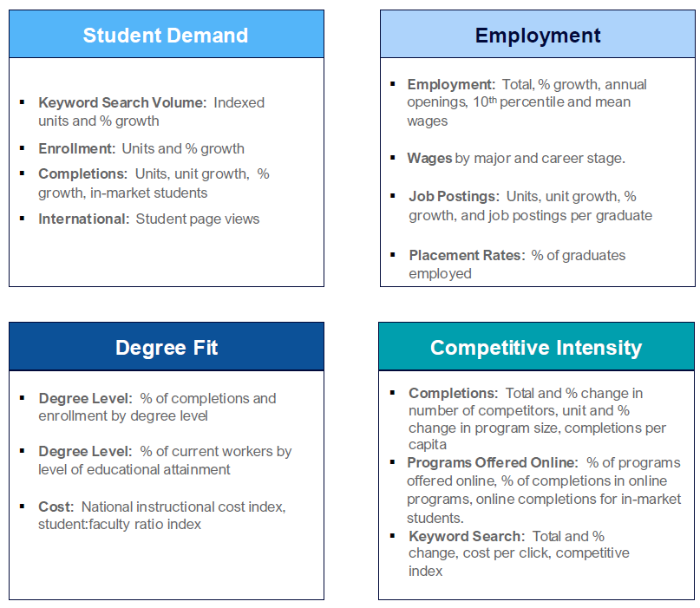
Gray Decision Intelligence Markets Tool
Where is it located:
GrayDI.us
Source:
External data aggregated by GrayDI to determine program attractiveness; Google, IPEDS, National Student Clearninghouse, BLS, Job Postings Data, ACS, GrayDI proprietary data
Who has access:
50 FHSU licenses; Deans/Chairs/Directors
Data/Information you’ll find:
Enrollment/Completions data; Employment projections, Placement of Graduates, Program Delivery benchmarks (cost); Wages of program graduates
Potential use cases:
*Competitive analysis
*Start/Stop/Grow program opportunities
*Alumni analysis

Slide 12
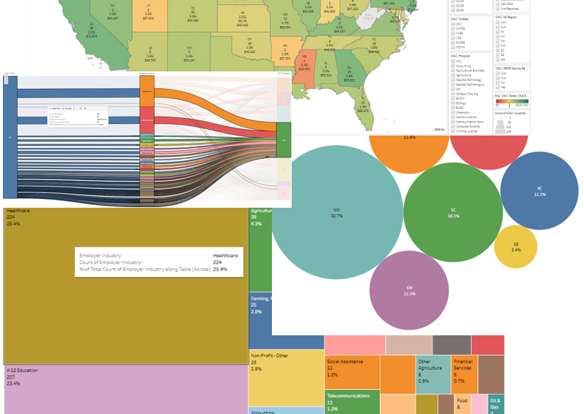
Career Services First Destination Survey (FDS)
Where is it located:
Tableau Cloud
Source:
internal results from Career Services first destination survey conducted on domestic undergraduate students
Who has access:
Deans/Chairs/Directors
Data/Information you’ll find:
Student provided graduation outcomes, identified employers, wages, post-graduation location, program of study, origin location
Potential use cases:
*Student origin to destination by program
*Wage/employer/location by program of study
*Job function & industry identified

Slide 13
Why does it all matter?

