Slide 1
Getting to Know Internal Auditing
The Profession that Makes a Difference
Presenter:
Organization
Date
Presentation is complements of The IIA Academic Relations
Notes:
Welcome the students and lightheartedly tell them that you believe everyone will want to be an internal auditor after they hear this presentation.
Before showing the next slide ask the group how they would define internal auditing.
For those answers not correctly answering the question, ask directing questions to get the students to begin to develop a broad definition and then say, let’s see what The Institute of Internal Auditors has to say about internal auditing.

Slide 2
What’s Internal Auditing?
“Internal auditing is an independent, objective assurance and consulting activity designed to add value and improve an organization's operations. It helps an organization accomplish its objectives by bringing a systematic, disciplined approach to evaluate and improve the effectiveness of risk management, control, and governance processes.”
Notes:
Explain the underlined terms as they are key terms in the definition.

Slide 3
High level comparison
Internal Audit
Financial Statement Audit
Broad focus
Accurate financials
Efficiency/effectiveness
Accomplishing objectives
Compliance w/laws, policy
Safeguarding assets
And more!
Diverse skills sets are required
Integral part of the organization
Specific focus
Accurate financial statements
Going concern
Reviewing historical data
Compliance with accounting and other regulations
Primarily accounting skills
Independent from the organization
Notes:
Many students (and others) think internal auditors focus on only financial aspects of a business or government entity. They also don’t know the difference between internal and external auditing.
Review this slide as a typical generic differentiation.

Slide 4
Internal Auditors Assess Risks…
To help keep bad things from happening
To help assure good things can happen
To help management understand
Where their risks are
Whether the risks are under control
Whether the risks are worth taking
Notes:
Provide examples from your experience or from stories you have heard to make the points on the bullets in the slide

Slide 5
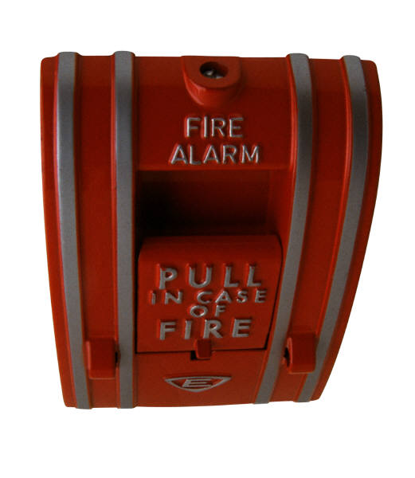
Finding Risks is Not Enough
Internal auditors evaluate the controls that help organizations manage risks
Are controls in place?
Do the controls work?
Are additional controls needed?
Are there unnecessary controls?
Are the controls cost-effective?
Notes:
Control - Any action taken by management, the board, and other parties to manage risk and increase the likelihood that established objectives and goals will be achieved.
Tell the students, Internal auditors must help management understand the importance of identifying what could go wrong in their organizations. Then they will usually help management, through recommendations or consulting, find ways to manage those risks that cannot be avoided and “these means” are called controls.
Provide a few examples of risks and contrrols that might be used to manage the risks.

Slide 6
Five Critical Tasks
Determine whether controls are adequate
Suggest improvements to increase efficiency and effectiveness or to lower operating costs
Determine whether policies and procedures are followed
Determine whether laws and regulations are being obeyed
Detect fraud or manipulation of records
Notes:
Internal auditors examine every phase of operations to insure that all company assets are properly recorded and safeguarded and that company operations are conducted in an efficient and businesslike manner. Auditors are responsible for performing five critical tasks…
To make the presentation a little more fun, you could ask for examples of “red flags of fraud” . Ask, “What are some activities that might make one think there could be fraud occurring?” Spend a couple minutes showing how these red flags could and could not identify fraud. Then make sure you point out that finding fraud is not a primary responsibility of the internal auditors.

Slide 7
Effective Governance
Board of Directors
Internal Audit
External Audit
Management
Notes:
The four cornerstones of effective governance.
Think of it like a four-legged stool: take away any one of the legs and the stool might still balance but the risk of an accident goes up…

Slide 8
Maintaining Independence: Dual Reporting Relationships
About 80 percent of Chief Audit Executives (CAEs) report functionally to the Audit Committee/Board of Directors
Independent from audited activities
Wide authority
Most common administrative reporting relationship is to the President/CEO
Notes:
Explain that for internal auditors who work for the organizations they audit (not consultant or audit services organizations), objectivity and independence in word and in spirit must be adhered to at all times.
Outsourced or Co-sourced internal audit activities must also remain independent.
Just because an organization pays your salary or consulting fee, it does not mean they are allowed to direct or sway your audits and reports.

Slide 9
Meeting Diverse Stakeholder Needs
Key Stakeholders
Audit committee/ board
Secondary Stakeholders
Other business unit executives
Tertiary Stakeholders
CEO
CFO or individual to whom CAE reports administratively
Potentially, other chief officers
External auditors and regulators
Investors and creditors
(Government audit) citizens and taxpayers
Potentially, the general public
Investment analysts
Employees and retirees
Notes:
Who the internal auditors report to or focus on is very diverse. Explain why these stakeholders are tiered the way they are. Also, highlight a few of the responsibilities internal auditors have to a few of the stakeholders mentioned above.

Slide 10
Internal Auditors
Find out what’s working and what’s not
Keep an eye on the corporate climate
Look at the organization with fresh eyes
Look beyond the financial statements
Advocate improvements
Raise red flags
Tell it like it is
Notes:
Address this slide with examples from your experiences.

Slide 11
Auditors Tell It Like It Is
Keep senior management aware of critical issues
Ensure factual communications of financial, operational and compliance data
Make suggestions based on knowledge of operations throughout the organization
Notes:
Although the slide is self explanatory,. Make sure the students understand the importance and impact of these statements.

Slide 12
What would you say…
If someone asked you whether or not their organization needed internal auditors?
Notes:
Get the class involved here, especially if the presentation has not been interactive to this point.
Wen they say, “Yes” ask why and good-naturedly challenge them a bit so they can reinforce what you have been telling them.

Slide 13
When Does a Company Need an Internal Audit Function?
Internal audit is not legally required in the U.S.
Exceptions: NYSE-listed corporations and a few specific industry/government requirements
Required in some countries
Every organization, regardless of its size, should have some type of internal control system/process
The IIA believes that an organization is best served by a fully resourced and professionally competent internal auditing function
Notes:
The internal auditing process provides assurance to management and the audit committee that risks to the organization are understood and managed appropriately. And it serves as an in-house consultant on many areas of interest.
Internal auditing practitioners are charged with assisting the organization in the effective discharge of responsibilities, promoting the establishment of cost-effective controls, assessing risks, and recommending measures to mitigate those risks. An integral part of the management team, internal auditors furnish top management with analyses, appraisals, counsel, and information on the activities they review, and monitor organizational ethics.

Slide 14
What will an Internal Audit Function accomplish?
Will it reduce liability or help control risks?
Will it free management to focus on core mission?
Will it improve the accuracy of financial and operational information?
Do we need a second opinion?
Can we improve service delivery?
Will it improve financial results?
Notes:
Hopefully, if internal auditors are doing their jobs and management believes in their value.
That is not the point of an internal audit function. One way management focuses on its core mission is to make sure it is managing the risks that could occur and keep management form meeting its objectives and mission. IA provides an overview, advises and consults to assist management. The do not do management’s work.
It should. See #2
For what? To have an internal audit department? No. But according to The IIA’s standards, internal auditors must undergo a quality review every 5 years. Think of it as an audit of the internal audit function.
Perhaps
Perhaps

Slide 15
International Professional Practices Framework
Mandatory Guidance
International Standards for the Professional Practice of Internal Auditing
Definition of Internal Auditing
Code of Ethics
Strongly Recommended
Position Papers
Practice Advisories
Practice Guides
www.theiia.org or https://global.theiia.org
Notes:
Tell the students, “I have mentioned the Institute of Internal Auditors a few times in this presentation. The IIA is the global voice of the internal auditing profession. As we saw at the start, they have an internal audit definition. They also have a Common Body of Knowledge, an International Professional Practices Framework which includes their standards of internal auditing. They also have a number of certifications as well.
The slide shows the website if you are interested it seeing what The IIA is all about .

Slide 16
Questions?

