Slide 1
Office of Scholarship and Sponsored Projects
Spring 2018 Convocation

Slide 2
Misty Koonse
Office of Scholarship & Sponsored Projects Coordinator

Slide 3
External Grant Activity to Date*
Submissions $ 9,508,423
Funded $ 4,418,160
Pending $ 2,311,579
*As of May 1, 2018

Slide 4
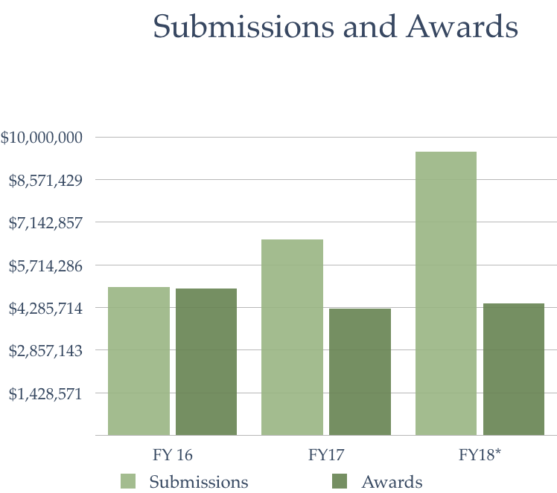

Slide 5
Human Subjects Research
Animal Use and Care
HIPAA
Responsible Conduct of Research
Financial Conflict of Interest
2,569 Registrants
1,185 course completions since 7/17

Slide 6
Institutional Review Board
Oversight of research involving human subjects
1,493 registered users on IRBNet
(148 new users since 7/1/17)
133 NEW submissions so far (7/1/17 - 5/1/18)
43 full reviews
29 expedited
99 exempt

Slide 7
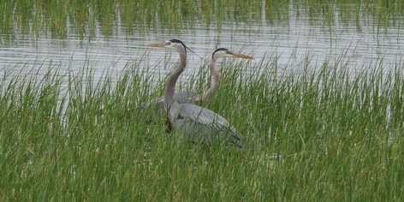
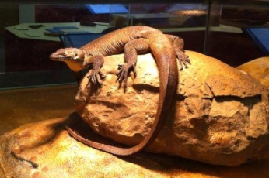
Institutional Animal Care and Use Committee (IACUC)

Slide 8
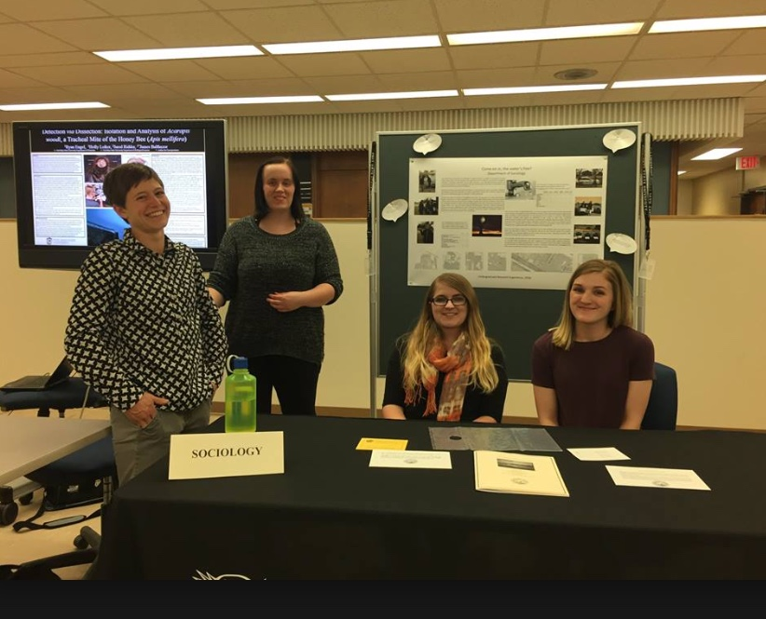
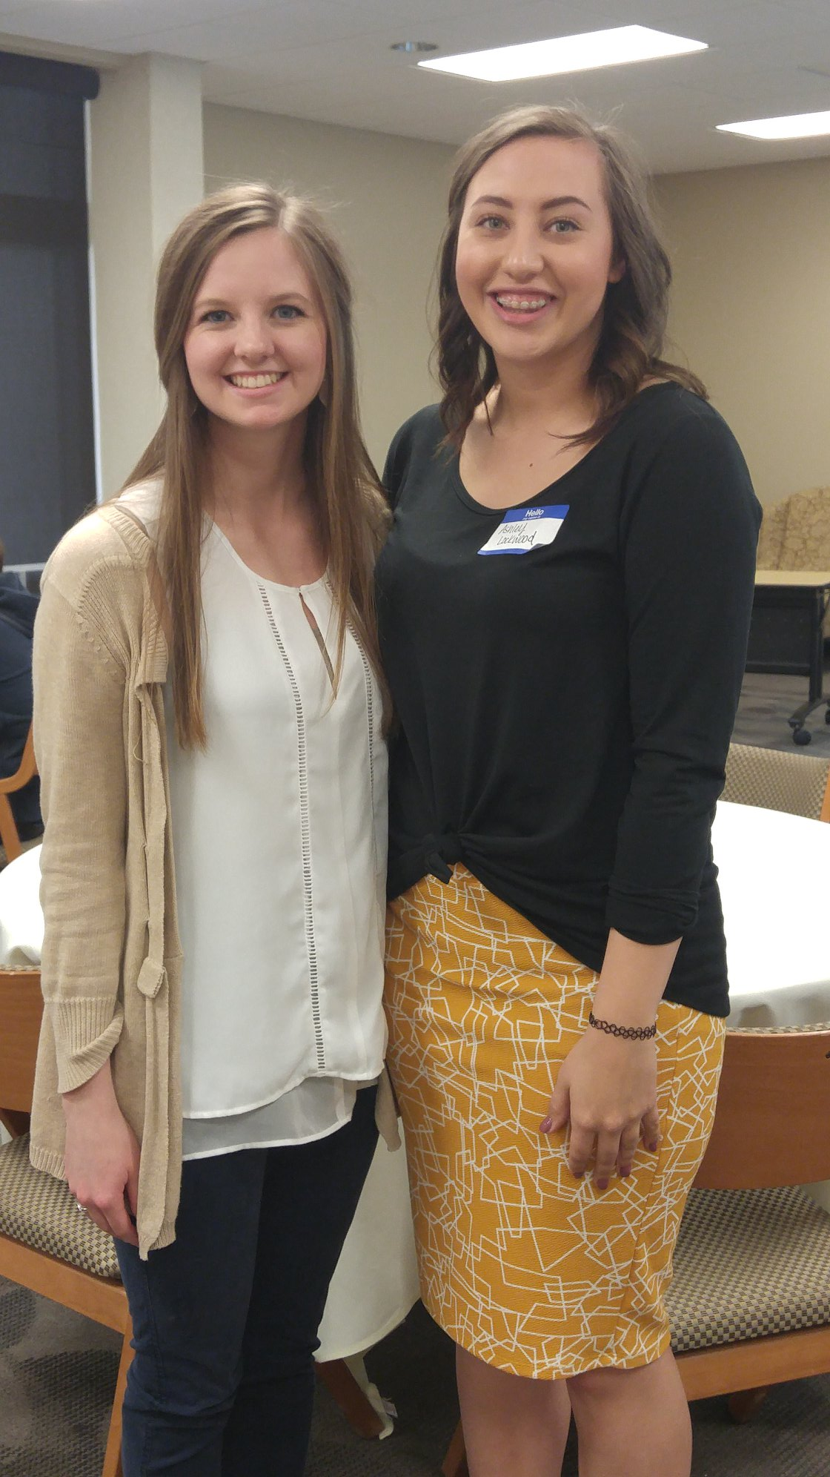
Undergraduate Research Experience

Slide 9
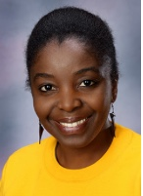
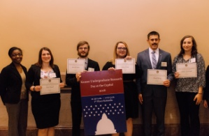
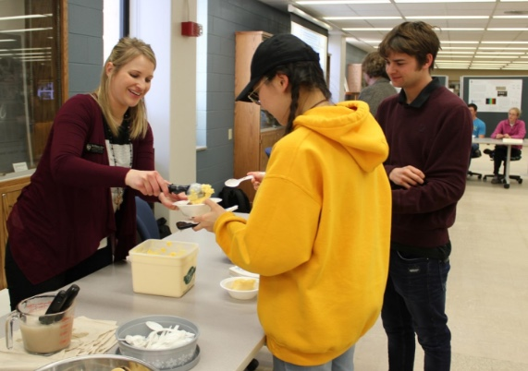
URE Highlights
URE grants
National Undergraduate Research Week
Night at the Museum
Heinrichs Outstanding Undergraduate Research Mentor Outstanding Undergraduate Scholars
Ice Cream Social
Workshops for students and faculty

Slide 10
URE Grants
16 Applications | 14 Funded
$54,594 | $41,362
Applications due September 5, 2018

Slide 11
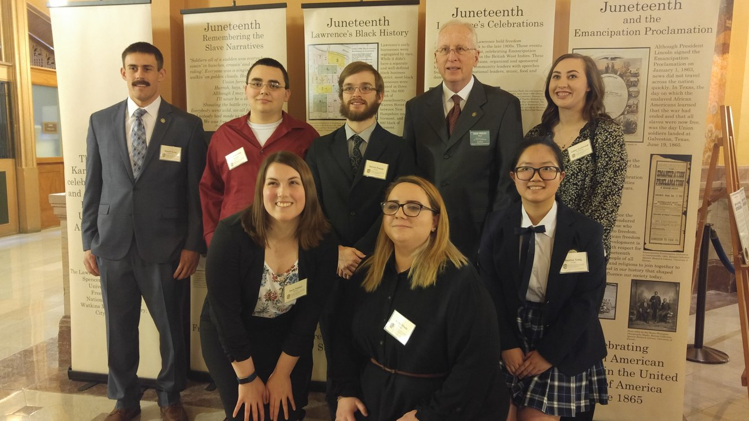
Kansas Undergraduate Research Day at the Capitol

Slide 12
Graduate Scholarly Experience Grants
Applications | Funded
35 | 23
$19,578 | $8,000

Slide 13
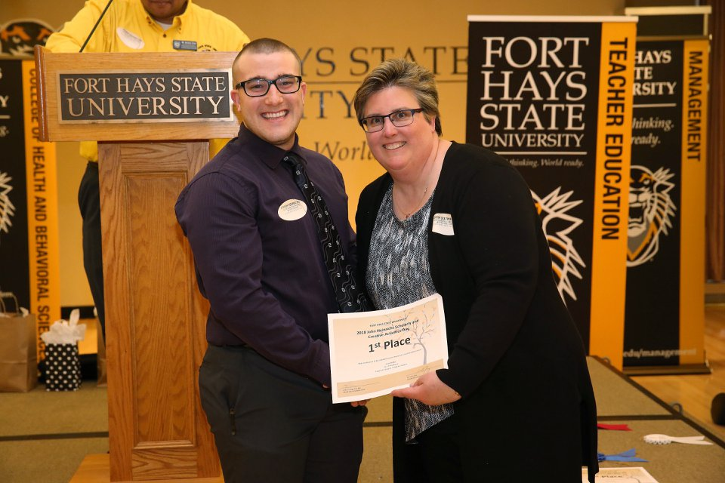
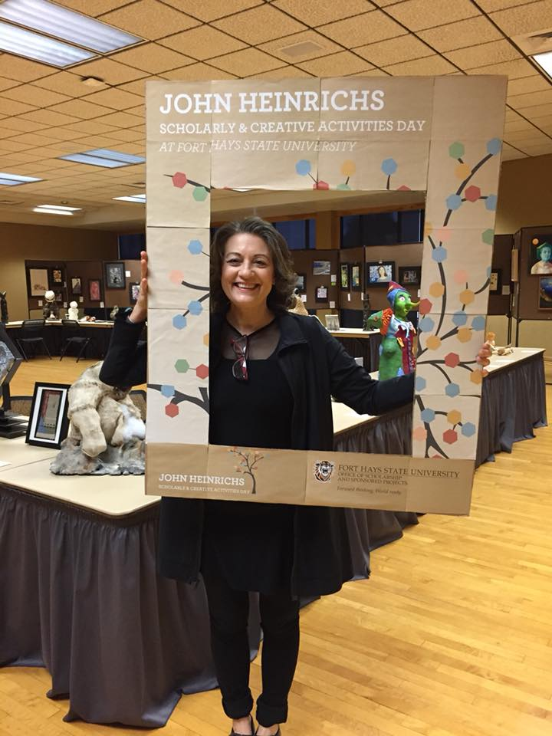
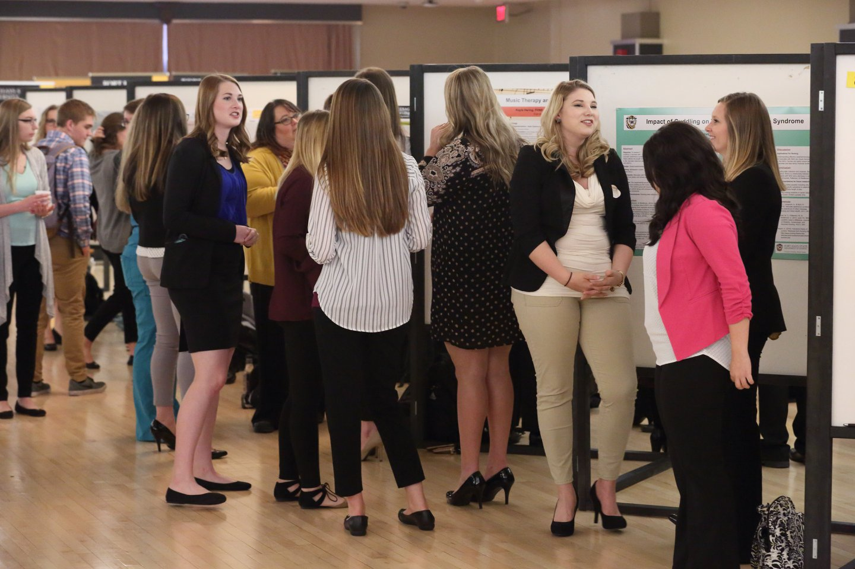

Slide 14
Thank you!
Have a great summer!

