Slide 1

STUDENT
CENTERED
DRIVEN
LED
STUDENT FISCAL SERVICES AND
STUDENT GOVERNMENT ASSOCIATION

Slide 2
TODAY'S GUIDE
STUDENT FISCAL
SGA
  STUDENT ACTIVITIES ACCOUNTS
  CASH BOXES
  CREDIT CARDS
  CASH SALES
  ALLOCATIONS
  APPROPRIATIONS
  EQUIPMENT FUND
  SGA FORMS

Slide 3
WORKDAY SECURITY ACCESS
  Gain security access to make cash sales or submit other financial transactions for the Student Activity account by email: sfsmail@fhsu.edu.
    Include: Your Name, FHSU ID, Organization Name, Officer Position, Cost Center Manager.
    Security Access will only be given to an organization officer or advisor.
  Student Fiscal Services will submit the request for access. The request will be approved by the Cost Center Manager, Director of SFS, and the Business Office.
  Your security access change may take 3-7 days (depending on the approval process).
  Students should use their name@mail.fhsu.edu to log into Workday.
  FHSU student employees will use name.se@fhsu.edu to log into Workflow forms. This includes: Cost Center Change Form, Travel Receipt Forms, Transportation Requisitions.

Slide 4
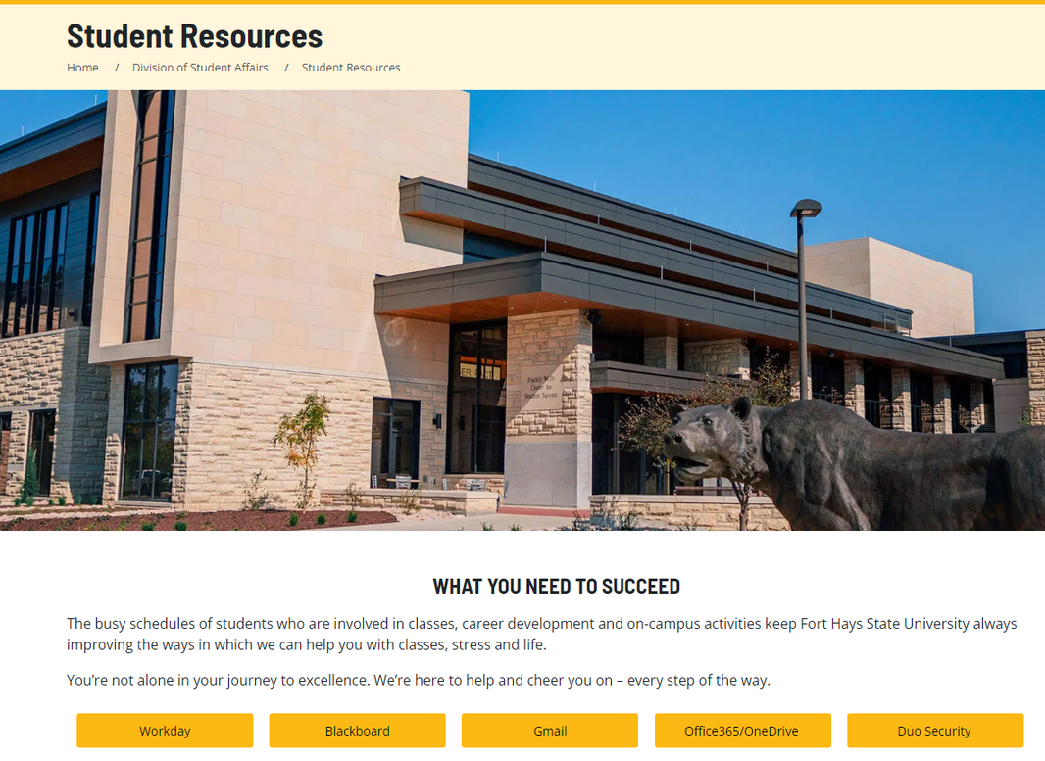
WORKDAY

Slide 5

STUDENT FISCAL SERVICES
Cash Boxes

Slide 6
STUDENT FISCAL SERVICES
CASH BOX POLICIES/GUIDLINES
- Step-by-Step procedures are found on the SFS website at:
https://www.fhsu.edu/workday/student-fiscal-services/
- Cash Boxes are for the purpose of making change.
- A maximum of $100 can be requested (or less if the cost center does not have adequate funds).
- Submit the request at least two business days in advance of the event.
- Cash Boxes are limited, so requests will be honored on a first-come, first--serve basis.

Slide 7
STUDENT FISCAL SERVICES
CASH BOX POLICIES/GUIDELINES
- Must be picked-up from SFS by 4:00 p.m. on scheduled work days.
- Only authorized individual(s) listed on the spend authorization can pick up the cash box with a photo ID. Funds may be automatically deducted from the cost center if not returned at the time specified.
- Return exact amount of cash as issued (in any denomination); your sales will be deposited as a cash sale.

Slide 8

STUDENT FISCAL SERVICES
Student Activity Credit Cards

Slide 9
STUDENT FISCAL SERVICES
STUDENT ACTIVITY CREDIT CARD POLICIES/GUIDELINES
- Step-by-Step procedures are found on the SFS website at:
https://www.fhsu.edu/workday/student-fiscal-services/
- Submit the spend authorization at least two business days in advance.
- Submitter is responsible for making sure that there is enough money in the cost center for the purchase prior to submitting the spend authorization.
- Only authorized individual(s) listed on the spend authorization can pick up the credit card, with a photo ID.

Slide 10
STUDENT FISCAL SERVICES
STUDENT ACTIVITY CREDIT CARD POLICIES/GUIDELINES
- Purchases are taxable unless purchased for resale.
Examples: Pizza purchased for meetings = TAXABLE
Food purchased to sell at Oktoberfest = NOT TAXABLE
T-shirts to resale at events or that will be reimbursed = NOT TAXABLE
- Only purchases requested and up to the authorized amount on the spend authorization can be made.
- Any unauthorized purchases or amounts exceeding the authorized limit will be charged to the activity account. The faculty sponsor will be responsible for taking the appropriate action to reclaim the fund due to the activity account.
- Obtain a tax exemption certificate for any items that are not taxable at the time of purchase. SFS will provide a note indicating if the purchase is taxable or not taxable.

Slide 11
STUDENT FISCAL SERVICES
RETURN OF STUDENT ACTIVITY CREDIT CARD
- SA Credit Card must be returned to Student Fiscal Services with an itemized receipt and by the End Date on the Spend Authorization. Usually the same day of check-out, and no more than 24 hours later.
- A credit card slip is not sufficient documentation since it does not list what was purchased. If the vendor cannot provide an itemized receipt, a Lost Receipt Verification form must be completed.
- If returning items after the credit card has been returned to Student Fiscal Services, contact Student Fiscal Services.
- Please follow the SFS Policies/Guidelines for credit card usage. Failure to abide by the SFS Policies/Guidelines may result in the loss of the use of SFS credit cards by an individual or the club.

Slide 12
STUDENT FISCAL SERVICES
RECORD A CASH SALE

Slide 13
STUDENT FISCAL SERVICES
CASH SALE HELPFUL HINTS
Step-by-Step procedures are found on the SFS website at:
https://www.fhsu.edu/workday/student-fiscal-services/
Most Commonly Used Revenue Categories:
Membership Dues (R00024)-R Non-Taxable
Food Sales (R00076)-R Taxable
Clothing Sales (R00087)-R Taxable
Most Commonly Misused Categories:
Dues, Memberships, and Subscriptions (529100)-R
Human Food for Consumption (532010)-R
Clothing(530100)-R

Slide 14
STUDENT FISCAL SERVICES
CASH SALE HELPFUL HINTS
Determine Tax Applicability Options:
-Taxable Sales (Destination) Use if a sale was made in Kansas but outside of Hays.
-Taxable Sales (KS Food) NEW - If your group sold food, contact SFS.
-Non-Taxable (Entity) A tax-exempt certificate must be attached to the cash sale or already on file with SFS.
-Non-Taxable (Out of State)
-Non-Taxable (Resale) A resale exempt certificate must be attached to the cash sale or already on file with SFS.
-Do not change Tax Applicability from Taxable Sales to Non-Taxable Item.

Slide 15
STUDENT FISCAL SERVICES
CASH SALE WITH MULTIPLE LINE ITEMS
Cash sales can include multiple line items for the following reasons:
-One payment type applying to multiple cost centers
-One payment type applying to multiple revenue categories
-Transactions with different Tax Applicability or Tax Codes
-To add multiple transactions of the same Payment Type to one Cash Sale, click the plus sign under Invoice Lines and complete all the required fields.

Slide 16
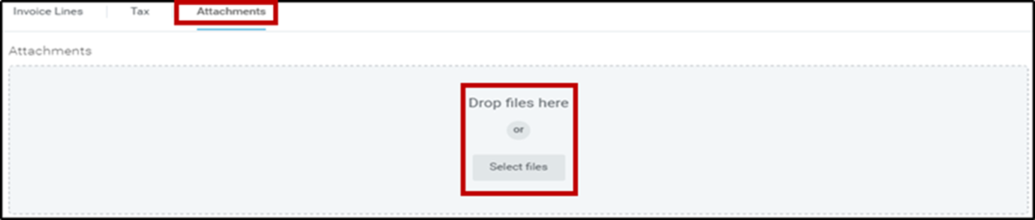
STUDENT FISCAL SERVICES
ATTACH BALANCING DOCUMENTATION
-Attach the Cash/Check Balancing Worksheet, as well as:
-Destination Sales Log Sheet, if applicable.
-Non-Taxable (Entity), a tax-exempt certificate must be attached to the cash sale in order for the deposit to be approved and processed.

Slide 17
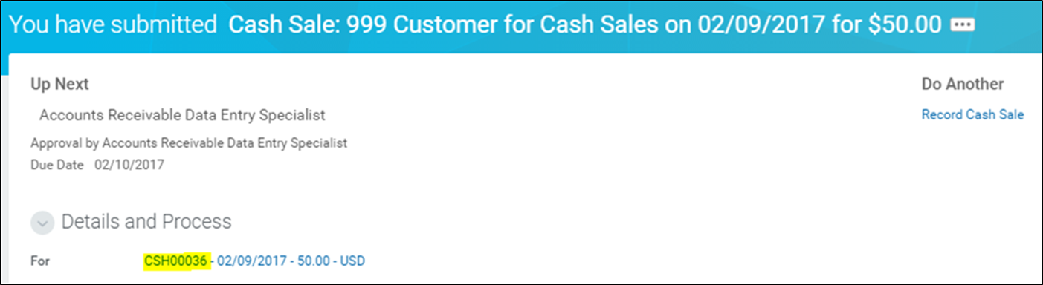
STUDENT FISCAL SERVICES
SUBMIT THE CASH SALE FOR APPROVAL
After you have submitted a Cash Sale it will be routed to SFS for verification and approval.
On the confirmation page, open the drop down under Details and Process to find your cash sale number. You will need this number when you complete the Security Deposit Bag.

Slide 18
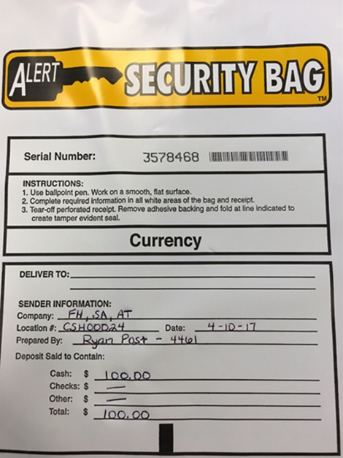
STUDENT FISCAL SERVICES
PREPARING THE SECURITY DEPOSIT BAG
Fill out the Security Bag in Entirety
Company: SA (Student Activity)
Location # -> Cash Sale number
Date (of deposit, not event)
Prepared By: Name & Phone Number
Total $ amount of cash sale
-Security Bags must be delivered in person to the SFS Office within 24 hours of submitting the Cash Sale in Workday!

Slide 19

STUDENT FISCAL SERVICES
FIND SAVED OR COMPLETED CASH SALES
-Open the Cash Sale from your Workday archive, or…
-Search the Cash Sale Number in Workday.
-Cash Sales in Draft Payment Status can be opened, changed if necessary, and submitted again.

Slide 20
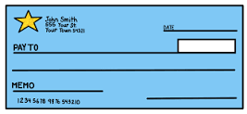
STUDENT FISCAL SERVICES
SFS DEPOSIT POLICIES & GUIDELINES
-Deposits are to be made at least once a week for any cash or checks received.
-Outdated checks (60 days +) will be accepted at the risk of the organization, not FHSU. If the bank rejects the check, the organization advisor will be notified and the funds will be deducted from the cost center.
Do not accept post-dated checks.
-When accepting checks, make sure that:
-They are payable to FHSU, not the Organization or personal names.
-The written amount (legal line) and numerical amount match.
-All checks are signed.

Slide 21
STUDENT FISCAL SERVICES
SFS DEPOSIT POLICIES & GUIDELINES
-Use an endorsement stamp, endorse the back side of the check with the Cost Center.
-Insufficient funds checks (or stale-dated checks) will be charged back to the Cost Center. The Cost Center manager (organization advisor) will be notified via Workflow and campus mail.
-SFS does not require individual receipts to accompany the deposit. However, receipts must still be retained by the department/student organization as they may be requested during an audit.
-Do not pay expenses out of sale proceeds. Reimbursements for expenses must be processed through the FHSU Workday system.

Slide 22

STUDENT FISCAL SERVICES
CONTACT
Email: sfsmail@fhsu.edu
Phone: 785.628.5251
Picken Hall 317

Slide 23
STUDENT GOVERNMENT ASSOCIATION
FUNDING SOURCES
-We have several options available for funding of groups like Allocations, Appropriations, and Equipment.
-Allocations is a process in preparation of the upcoming year where groups are funded for different trips, events, and speakers they will be bringing to campus or attending.
-Appropriations is a way to get money if your group received no Allocations or didn't apply for Allocations. You can receive $1,000 per group or $500 for an individual.
-Equipment is a funding source for student organizations to receive funding for equipment for their group. $1,500 per organization per fiscal year, and then can be matched dollar-for-dollar.

Slide 24
STUDENT GOVERNMENT ASSOCIATION
ALLOCATIONS
-This year's allocations for 24-25 have already been dispersed but allocations budgeting for 25-26 will open in November.
-Allocations can fund: Trips, speakers, on-campus events, etc.
-Allocations cannot fund: "Items considered “personal gain” will not be funded through any funding mechanism of the Student Government Association. This is consistent with the State of Kansas funding guidelines. Examples of personal gain include, but are not limited to:
  T-shirts, sunglasses, cups, key-chains, lanyards, or anything that is given out at an event
  T-shirts, notebooks, pins, stoles, or any other item given to members of an organization, unless the items are returned to the organization at the end of the academic year and are housed on campus
  Printing Costs (except for educational purposes – e.g. reusable educational posters)
Museum admission, theater tickets, or other admission fees

Slide 25
STUDENT GOVERNMENT ASSOCIATION
APPROPRIATIONS
-Appropriations is essentially the same as Allocations with the same things being funded like funding trips, speakers, on-campus events, etc.
-Yet again, the difference is if you received Allocations, you cannot receive Appropriations.
-Appropriations has the same parameters that nothing done with the funding can be used toward personal gain.
-Student Senate and the Appropriations Committee are the deciding factor on what we will fund with the Appropriations monies.

Slide 26
STUDENT GOVERNMENT ASSOCIATION
EQUIPMENT
-Student Organizations can fill out the form in Tigerlink if they are needing monies for equipment.
-This item/items must be stored on campus with the ability for other student organizations to use it.
-Student Senate and the Appropriations Committee are the deciding factor on what we will fund with the Equipment Monies.

Slide 27
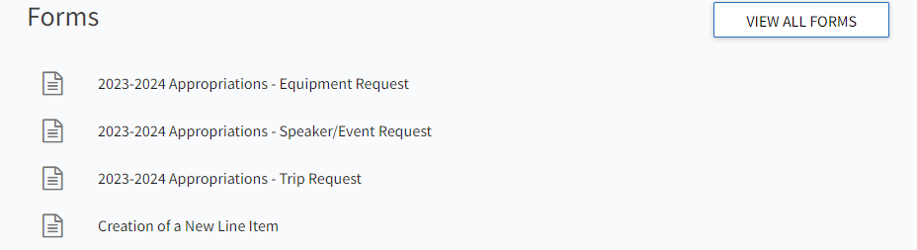

STUDENT GOVERNMENT ASSOCIATION
FORMS
-Forms for Appropriations, Equipment, line item changes for Allocations funding, and the creation of a new line item can all be found on Tigerlink.
-Simply go to SGA's Tigerlink Page click on forms and select the form you need to fill out. Or I have some QR codes I printed out for your convenience. If you are having trouble finding it simply reach out to me or stop by the office.

Slide 28
STUDENT GOVERNMENT ASSOCIATION
SGA TREASURER CONTACT
Email: jjsinsel.se@fhsu.edu
Phone: 785.628.5311
FWCSS: 238

Slide 29
STUDENT
CENTERED
DRIVEN
LED
FINANCES 101
BUSINESS AND PURCHASING OFFICE INFO

Slide 30
TODAY'S GUIDE
FINANCES 101
  TRAVEL 101
  PAYING FOR ITEMS
  REIMBURSEMENTS
  MANAGING YOUR FINANCES

Slide 31
YOUR MONEY
WHAT TO FOLLOW
  Please schedule an appointment for assistance - email purchasing@fhsu.edu or call 785.628.4250 or 785.628.4463.
  FHSU Student Activity and SGA procedures: Policies, Procedures, and Templates - Workday - this page has links to commonly used processes in Workday.
    Assistance with travel arrangements, Workday, and Workflow travel forms.
    Instructions and guidance for submitting supplier purchases by check/credit card.
    Assistance with Workday expense reports for personal reimbursement.
    Foundation forms for donations over $25 (use Gift Deposit form).
    Assistance submitting Oktoberfest forms- credit card check-out, cash box requests.
    Please note: Anything with a FHSU logo must be approved by University Marketing prior to purchasing - creative@fhsu.edu

Slide 32
PURCHASING OFFICE
COST CENTER BALANCES
  You are responsible for maintaining your organization's records!!!
  To check your balance:
    Workday Finance Reports
      Select Cash by Cost Center (Total)
      Be sure to change the Company code to SA for Student Activity balances.
  Maintain all supporting documentation, including:
    SA/SGA cost center reconciliation documentation, customer receipt books, copies of invoices/supplier receipts, travel related receipts, etc.

Slide 33
ACCOUNT DIFFERENCES
CREDIT CARD PAYMENTS
Student Activity Accounts
  Credit Cards are checked out through SFS.
  Used to pay for items that SGA is not paying for.
    Travel - (NON-SGA Money)
    Oktoberfest items for resale.
    Items for club members such as shirts, supplies, etc.
SGA Allocations/Appropriations
  A state issued P-Card is used to pay for items.
    If you do not have access to the P-Card the purchasing office, an administrative employee in a department, or the on-campus advisor for the group can help make them.
  These are purchases that are being paid for by state funds and are approved allocations through SGA.

Slide 34
CONTRACTS
WHAT TO FOLLOW
All contracts and agreements for events, speakers, etc. require pre-approval. General Counsel reviews the document(s),
the President of FHSU or Vice President of Administration & Finance are the only people authorized to sign the contract or agreement.

Slide 35
PAYING FOR ITEMS
BUSINESS OFFICE
  Expenditures are processed through the FHSU Workday system
  Purchases cannot exceed the organization’s account balance
  SGA vs. Student Activity Funds
    SGA Allocations and Appropriations must follow SGA, University and State of Kansas guidelines.
    Student Activity funds have fewer restrictions and allow more flexibility
      Student Activity accounts are NOT tax exempt (unless purchasing for resale)
  Gifts, Prizes and Awards expenditures must follow strict guidelines. For details regarding these purchases review the full policy and procedure: Gifts, Prizes and Awards.

Slide 36

PAYING FOR ITEMS
WITH A CHECK
  If a business does not accept credit card payments, a supplier invoice will need to be submitted in Workday to pay them by check.
    Follow this procedure to create a supplier invoice in Workday: Create Supplier Invoice.
  DO NOT wait until invoices are due to initiate the process to request a check. The approvals and processing of the check can take several days, and student organizations do not want to run the risk of being assessed late fees on invoices.

Slide 37

REIMBURSEMENTS
PAYING PEOPLE BACK
  From student activities account:
    follow the Create Expense Report-SA Company to process reimbursement to the individual.
  from SGA funds for travel related expenses:
    prior to the trip a Travel Receipt Form must be started in the Business Office workflow and a Spend Authorization will need to be submitted Create Spend Authorization for Trip Approval.
    After the trip is complete, finalize and submit the Travel Receipt form and follow the Create Expense Report: FH Company - For Travel Expenses or Create Expense Report: FH Company - Student to submit the expense report for reimbursement.
  Unless it is the only option, it is NOT recommended that individuals pay personally for expenses. Reimbursements can take time to process, thus potentially creating a financial burden to the individual.

Slide 38

NOT ALLOWED EXPENSES
THINGS NOT TO DO
  Illegal purchases: lottery tickets, alcohol, drugs, tobacco, or other purchases not in accordance with University policies.
  Purchases without an itemized receipt.
  Advisor expenses from SGA.
    Advisor expenses from SA funds must be approved at a club meeting—minutes of the meeting must be attached to the expenses.
  SGA funds cannot be used for fundraising.
    SA funds are allowed for fundraising, see Fundraising Project Policy in the Student Organization handbook PRIOR to hosting a fundraising event.
      Any organization considering a raffle must contact Student Engagement in advance for guidance and approvals.

Slide 39
TRAVEL 101
PRIOR TO TRAVEL
  Traveling FHSU Policy for Educational Travel:
  Print, complete, and sign the appropriate Student Waiver, Release, and Indemnification Agreement form (#1 or #2). This form can be hand delivered to the General Counsel Office in Sheridan Hall #314 or emailed to hlkaiser@fhsu.edu.
  Please allow 6-8 weeks prior to the departure date when using SA or SGA allocations, including; airfare, lodging (cannot be prepaid), and registrations.
  SGA appropriations contact the Purchasing Office for reimbursement – copies of itemized receipts will be required!
  ALL travel requires trip approval! Submit a Spend Authorization for Worker in Workday.
    'Worker’ would be the student employee, faculty/staff traveling, or advisor.
    Groups will submit under either faculty/staff traveling or advisor.

Slide 40

TRAVEL 101
PAYMENT
  Student Activity funds: a Student Activity credit card should be checked out from SFS to pay for expenses.
  SGA Allocations: a state p-card should be used to pay for expenses.
    If the student organization doesn’t have access to a state p-card, contact the Purchasing Office, an administrative employee in a department, or the on-campus advisor for the group. If you are an Ag-related group, please contact the Ag Department.
  Need Assistance with travel?
    For questions on the logistics of travel and compliance with policies and procedures, contact the Business Office.
    For assistance with making arrangements and/or submitting forms, contact the Purchasing Office.
    For a complete list of University travel policies and procedures go to FHSU Travel Policy Manual.

Slide 41

TRAVEL 101
MEALS
Student Activity Accounts
  Student Activity credit card can be checked out and taken on trips to cover student meals.
  Students can pay personally and be reimbursed after the trip.
  Advisor can pay personally for student meals and get reimbursed; however, a certification of expense form will have to be completed and signed by each student.
    Advisors with a p-card MUST NOT use them for meals!!!
SGA Allocations/Appropriations
  Student groups typically are not allocated funds for meals
  Meals are reimbursed to the traveler (after the trip) based on the daily M&IE rate. Meal allowance is determined by the destination, departure times and arrival times of travel.
  Some situations may warrant a cash advance being distributed to students for meals.
  Advisors MUST NOT use their state p-card or personal funds to pay for student meals!

Slide 42

TRAVEL 101
LODGING/STAY
  LODGING CANNOT BE PREPAID.
    Reservations can be made to hold rooms and under certain circumstances a one night’s deposit may be required, but the full stay cannot be paid in advance.
      Airbnb’s only option is to pay in full when making the reservation. As long as this is a more economical option vs. a hotel, the prepayment is allowed.
  Lodging rates are established by the State of Kansas and are determined by the destination of travel and the month that the travel occurs in. Rates can be found on the Business Office webpage, Expenses/Travel section.
  Itemized receipts are required and must show the room rate, miscellaneous costs and taxes charged.
    Note: If travel is paid from state funds and travel is in the State of Kansas, tax should not be paid to the lodging establishment.

Slide 43

TRAVEL 101
TRANSPORTATION
Employees and students traveling on university business are required to use the most economical and advantageous modes of transportation.
  Detailed information regarding transportation policies can be found in the FHSU Travel Policy Manual
POSSIBLE COMPLICATIONS
    Are you traveling separate from other travelers for personal reasons?
    Are you leaving or returning somewhere other than your official station?
    Is someone going with you that isn’t on state business?
    Are you extending your trip for personal time?

Slide 44
TRAVEL 101
AFTER TRAVEL TO-DOS
  SGA appropriations contact the Purchasing Office, an administrative employee in a department, or the on-campus advisor for the group. If you are an Ag-related group, please contact the Ag Department for reimbursement – copies of itemized receipts will be required!

Slide 45
CONTACT INFORMATION
Email: purchasing@fhsu.edu
Phone: 785.628.4250
Webpage
Sheridan Hall 318
PURCHASING
OFFICE
Email: apayable@fhsu.edu
Phone: 785.628.5948
Webpage
Sheridan Hall 106
BUSINESS
OFFICE

