Slide 1
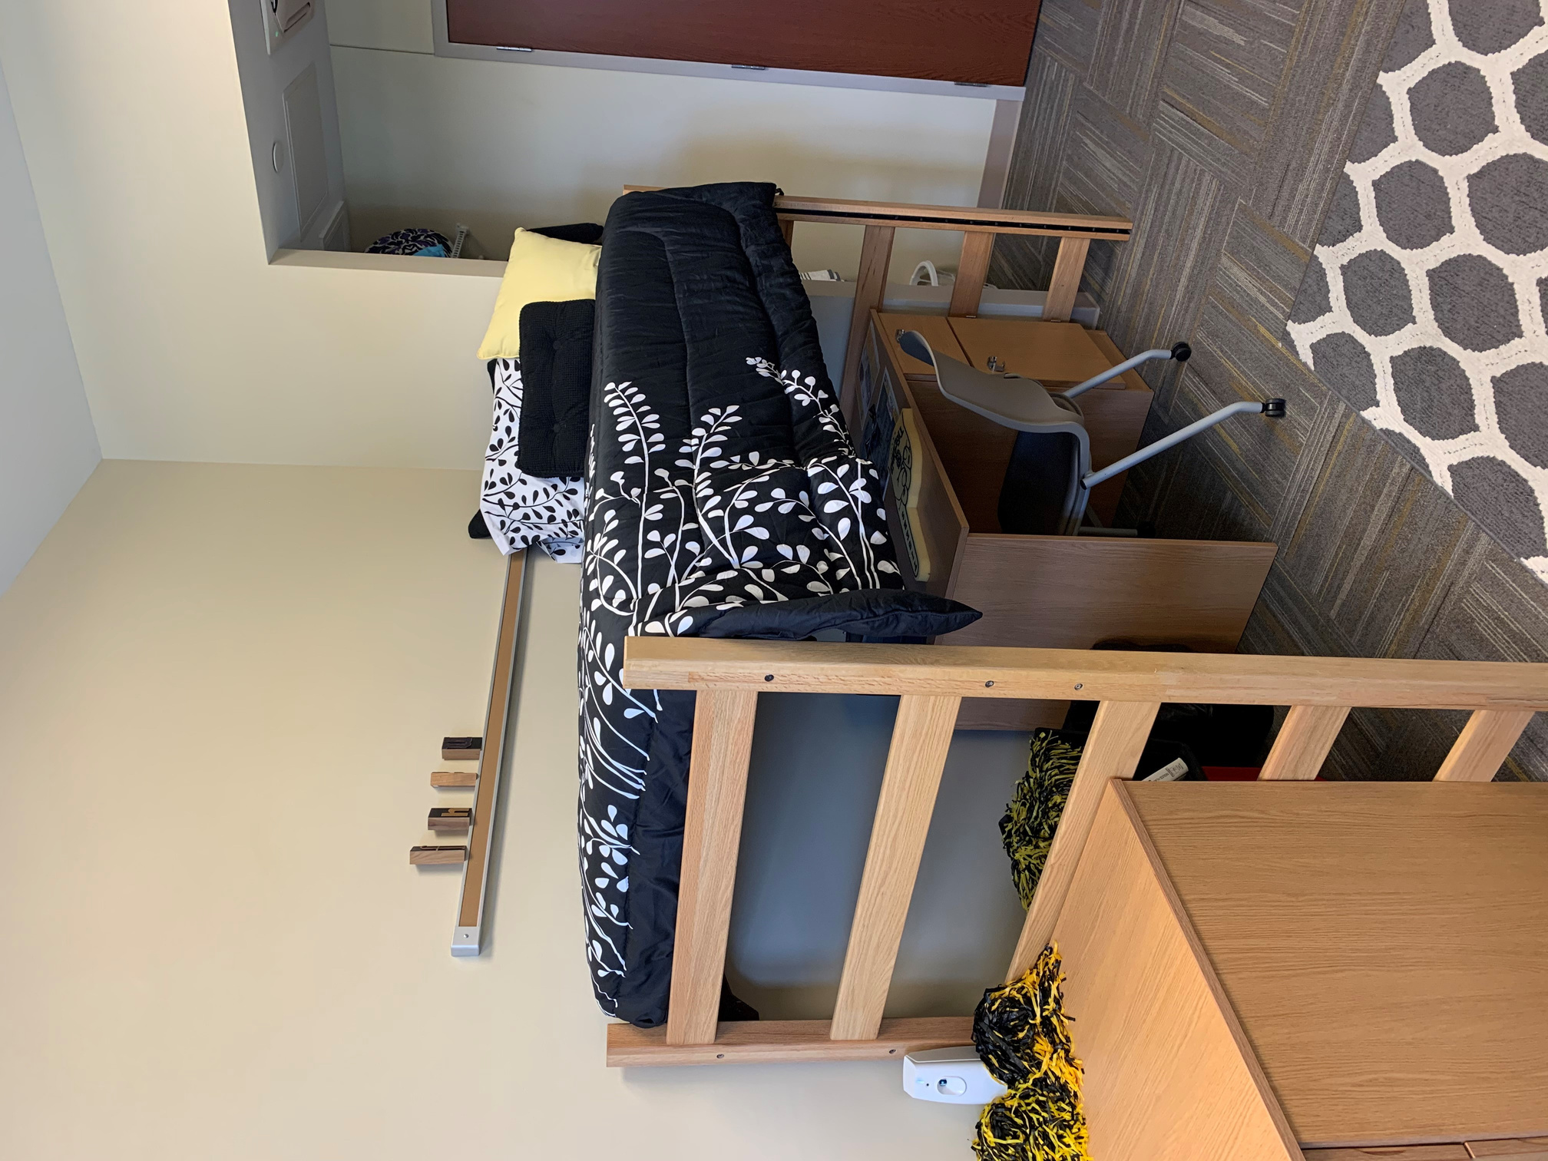
VICTOR E. VILLAGE

Slide 2
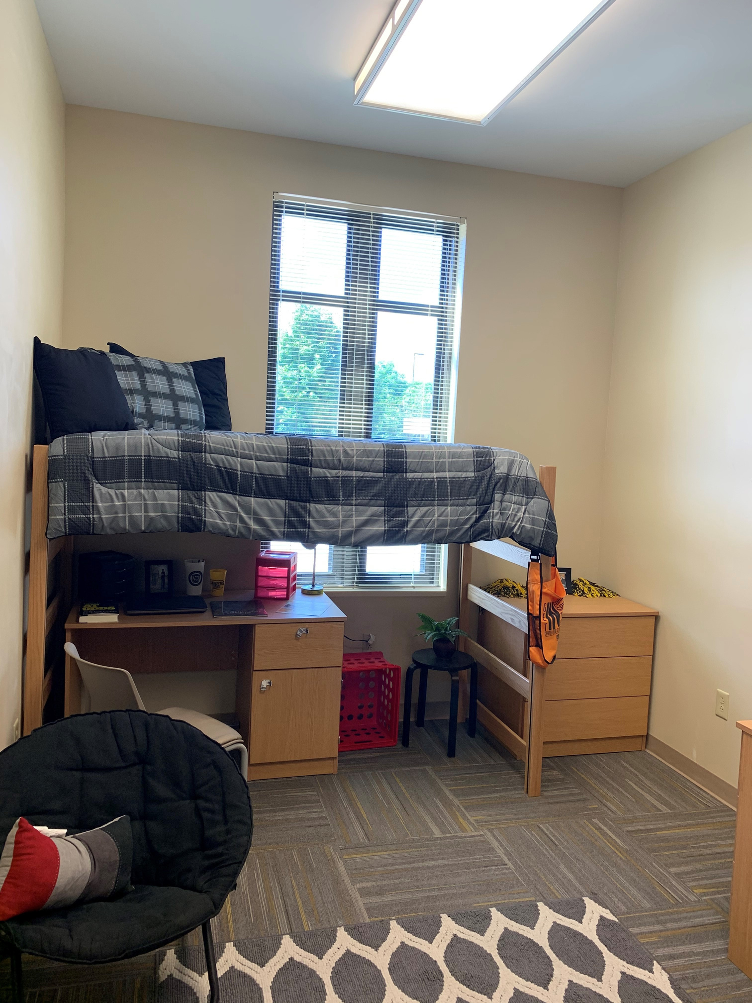
VICTOR E. VILLAGE

Slide 3
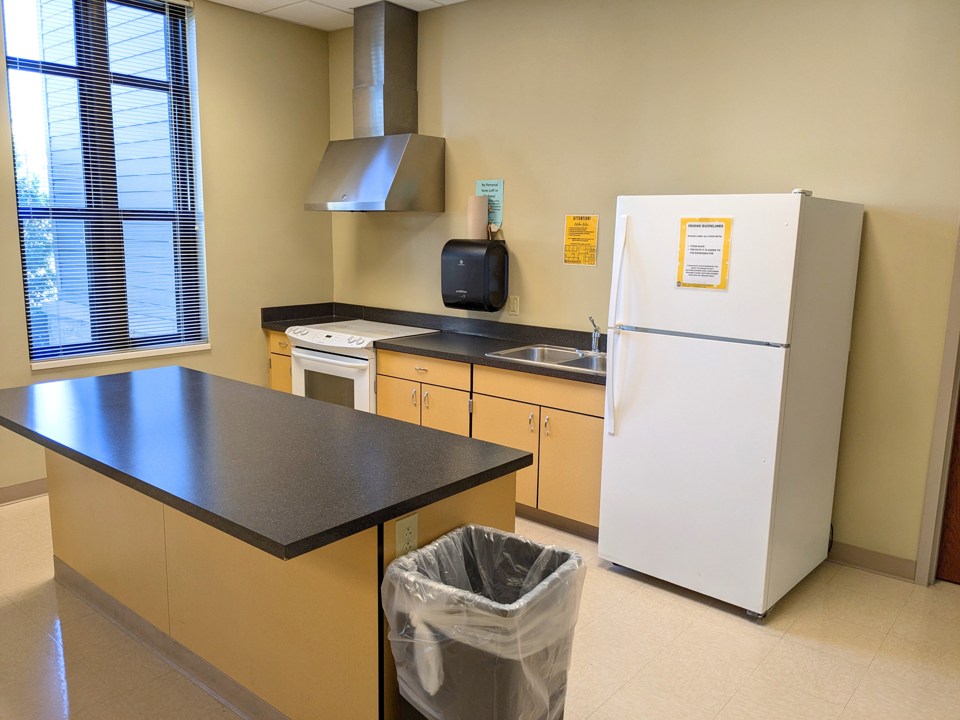
VICTOR E. VILLAGE

